Slide 1
Deploying ML Models for Faster Micro-Architectural Simulation
Presented By
Parisa Surya Teja
152002014
M.Tech SoCD

Slide 2
AIM
To improve the performance of a Micro-Architectural Simulation, by reducing the memory latency with Performance Modelling techniques, and to deploy Machine Learning models.

Slide 3
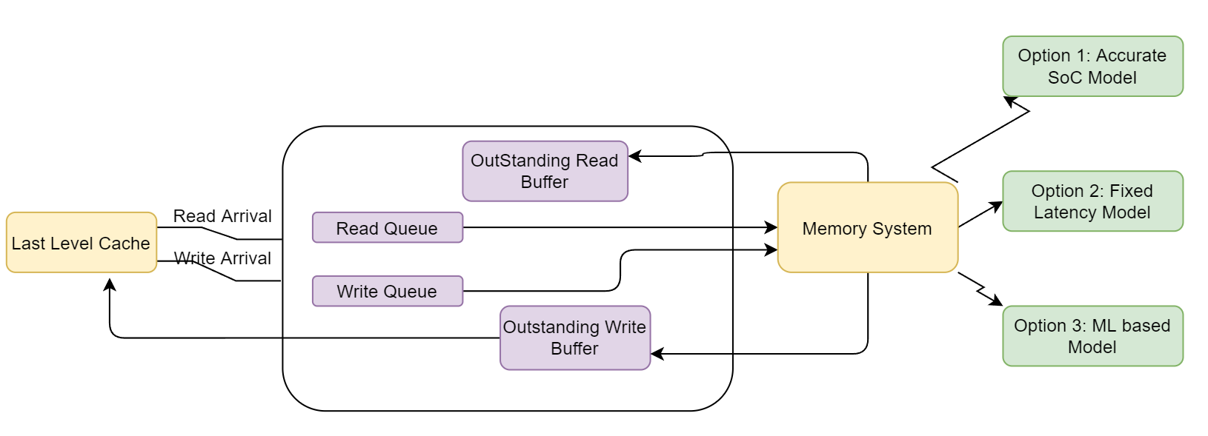
Overview
Processor core predicts all memory latencies beyond L3 Cache.
Beyond L3 - L3 Cache misses, L3 Cache evicts.
No need for modelling, if we can predict memory latencies faster and accurately.

Slide 4
Models for Memory Latency
1. Accurate SoC Latency Model
2. Fixed Latency Model
3. Machine Learning based Latency Model

Slide 5
Accurate SoC Model
Accuracy - Best
Complexity - Highest
Runtime - Highest

Slide 6
Fixed Latency Model
Accuracy - Worst
Complexity - Least
Runtime - Least

Slide 7
ML based Latency Model
Accuracy – Intermediate (Closer to SoC)
Complexity - Intermediate
Runtime – Intermediate
RNNs used LSTM, BiLSTM, GRU

Slide 8
Benchmarking
Tests - SPEC 2017 benchmarks- Standard Performance Evaluation Corporation.
The benchmark Suite - Integer Benchmark and Floating-point Benchmark.
Hierarchy➔ Suite -> Benchmarks ->Traces -> Region of Application.

Slide 9
Studies Conducted
Comparison of Measured Latency and Predicted Latency.
Investigation on Very High Latency Values.
Experimenting with Features.
Decrease the number of parameters in the model.
Splitting Physical Address.
Clustering N Models Optimizations.

Slide 10
1.Comparison of Measured Latency and Predicted Latency
Latency
Measured Latency
Predicted Latency
SPECCpu suite traces are classified into three types based on memory transaction counts as small, medium and large.

Slide 11
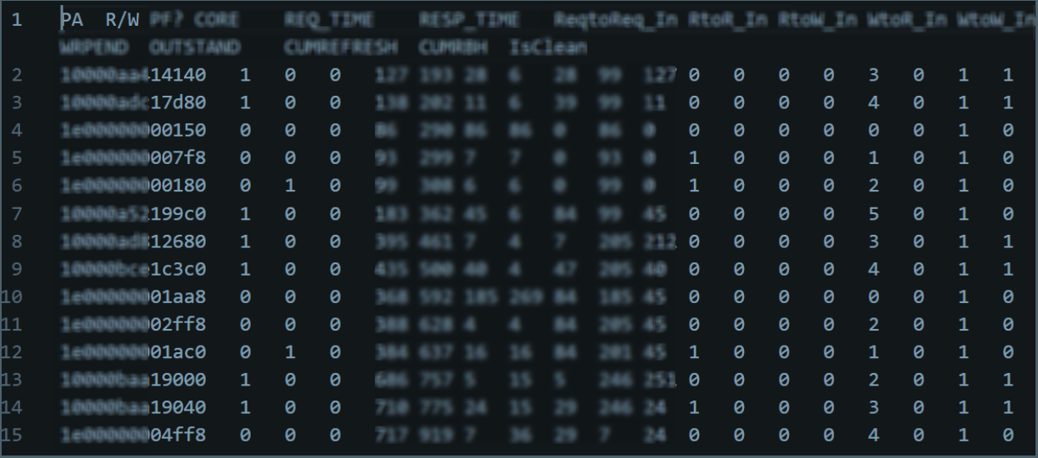
Correlation of Features with Latency
[I/D] Instruction type requests takes less latency than the Data type.
[R/W] Write requests takes less latency than the Read type.
[C/D] Write clean requests takes less latency than the Dirty type.
PA is directly correlated with latency.
Memory Log Dump file

Slide 12
Observations from Latency Comparision plots
1. All the memory transactions which have a huge difference in latency values are mostly read-only enabled.
2. For a transaction, if all the values are almost in the same range except attribute value WtoR In, then the difference in latency values changes enormously.
3. When measured latencies are very high, the ML model struggles to learn those transactions.

Slide 13
2.Investigation on Very High Latency Values
How to predict high memory latency values accurately?
Experimented few micro-architectural features.
Tried 3 different configs and one of them helped in reducing the spikes.
a. Soc model
b. Soc Config1
c. Soc Config2

Slide 14
Bucketizing the Latency Values
1. Soc model vs Soc Config1 feature.
When compared the Soc Config1 feature values with the Soc, Overall, the number of transactions count of latency values in the bucket b4 is decreasing and b5, b6 and above has drastic change in count.
2. Soc model vs Soc Config2 feature.
When compared the Soc Config2 feature values with the Soc similar trend as above was observed here.
3. Soc Config1 feature vs Soc Config2 feature.
There's no significant difference between above mentioned features in the latency range transaction count but Soc Config1 feature values are slightly increasing every where.

Slide 15
3. Experimenting with Features
a. Decrease the number of parameters in the model.

Slide 16
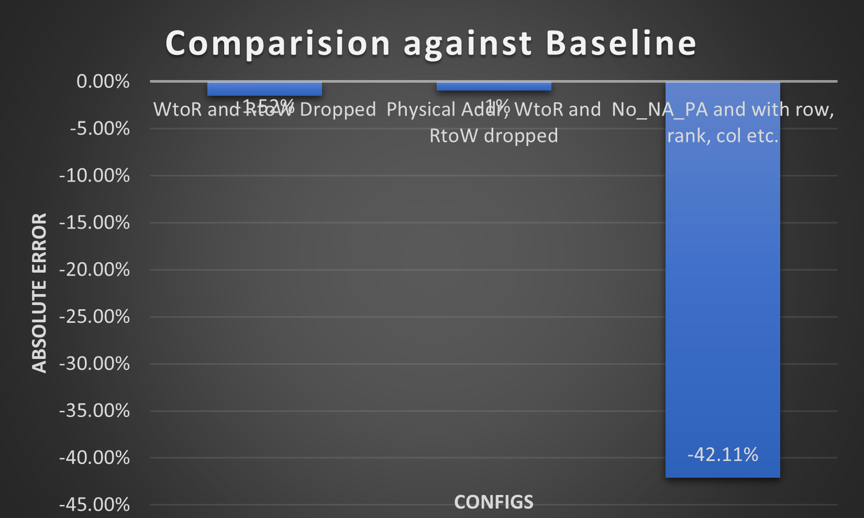
b. Improving Accuracy by Splitting PA
PA(>30 bits) -> row, bank, column, rank, channel and normalized address.
To check ML accuracy percentage two studies are made
On Client benchmark suite.
On Server benchmark suite.
Each study is experimented without pa and na.

Slide 17
4.Clustering N Models Optimizations
Clustering techniques used.
Density-based spatial clustering of applications with noise (DBScan) Clustering
Kmeans Clustering

Slide 18
Why Kmeans clustering is used?
1. Currently training approach – 1 model per trace.
2. Optimistic to achieve 1 model per N traces.
3. Single model is chosen by picking the largest trace in each cluster and treated as representative trace in that cluster.

Slide 19
Parameters used for KNN algorithm - UIPC, TotalCompletedReads, TotalCompletedWrites, AvgRdLatencyCycles, AvgWrLatencyCycles, AvgCleanWrLatencyCycles, AvgDirtyWrLatencyCycles, TotalCompletedReads+TotalCompletedWrites

Slide 20

(DBScan) Algorithm steps 1
Randomly pick a point from the all points and check whether its a core point or not
Parameters(User Input)
1. eps
2. minPts

Slide 21
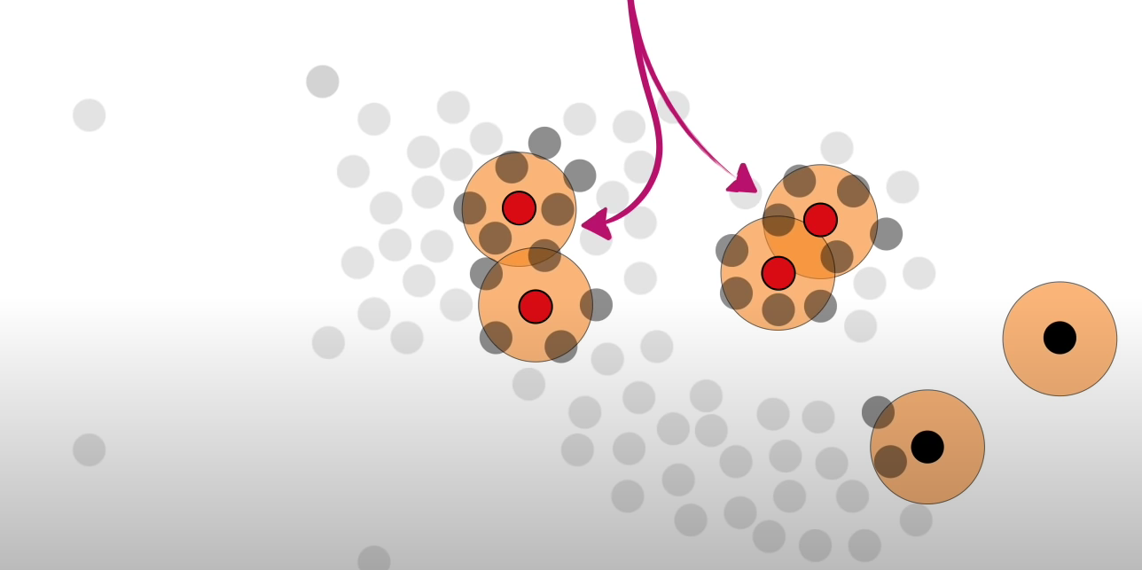
2
Complete the previous step for all the points to know a point is core or non-core point.

Slide 22
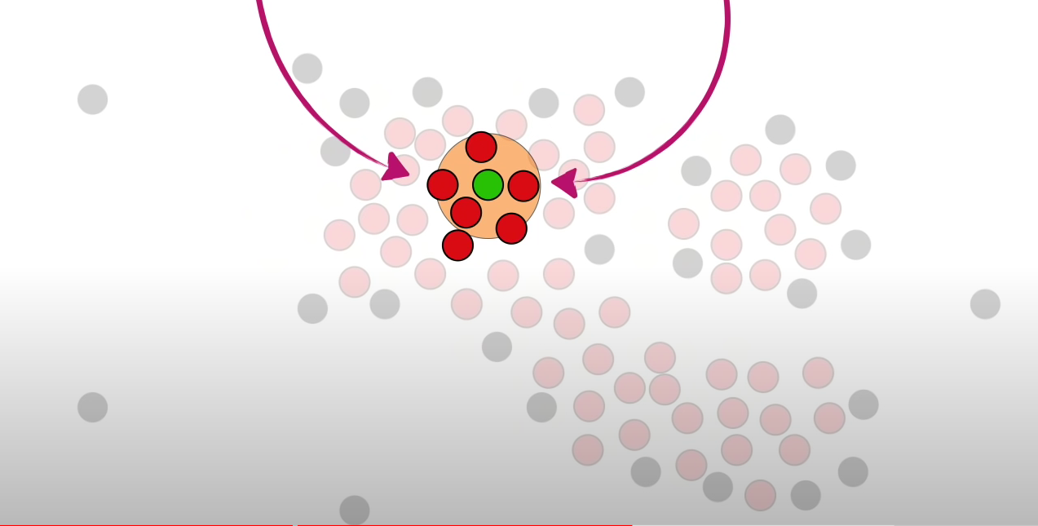
3
Randomly pick a core point, name it as cluster and core points nearest with distance < eps assign them to same cluster. Repeat the same for all core points.

Slide 23
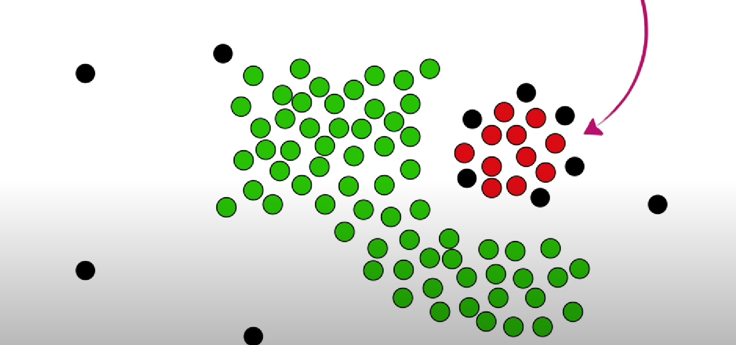
4
The core points which are away from the cluster forms the other cluster.

Slide 24
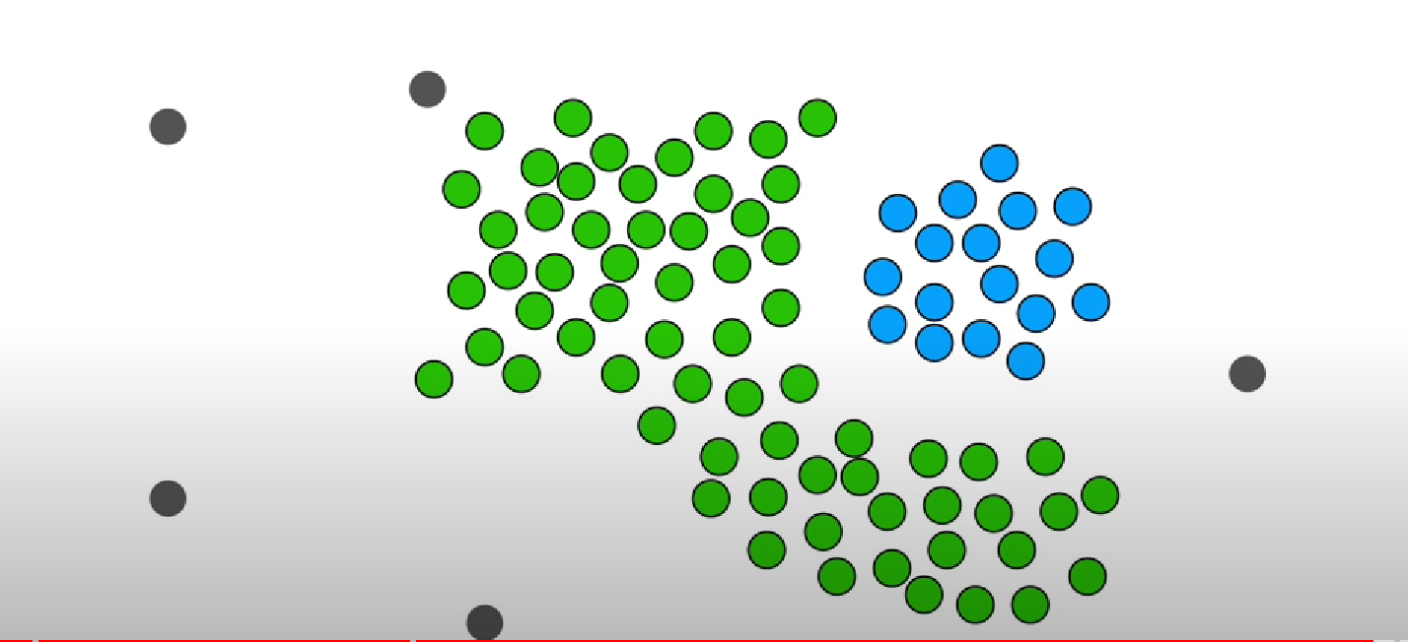
5
Clusters formed using DBScan

Slide 25
Clustering Results
Tried Kmeans with different K values 10, 20, 50.

Slide 26
Future Work
Challenges associated with ML
Some of them are first we need to handle cases like simulating with different SoC configurations in which for each configuration we need to generate one model.
We will also be running the simulation on various number of cores and with the different number of threads per core and again this will generate a huge number of models.

Slide 27
Conclusion
There is an improvement in reducing the error rate by removing the four parameters.
Bucketizing the memory latency values reveals the regions where more memory transactions are happening.
Comparing of predicted and measured latency reveals important observations.
Splitting of physical address parameter reduces the error percentage.
DBScan clustering algorithm provides optimal number of clusters in speccpu suite.
Applying the K-means clustering on the speccpu benchmark suite effectively reduces the training effort in terms of compute and wall clock time.
Finally using this ML infrastructure in other potential areas. as this project is Proof of Concept for using ML models integrated with the simulator, that can be used for future applications.

Slide 28
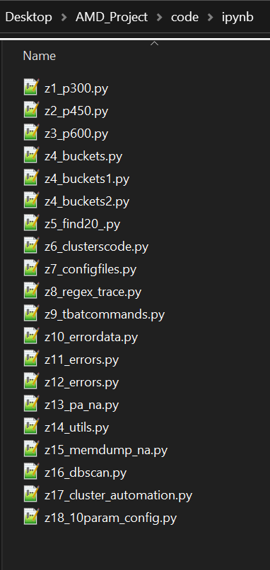
Contribution
Parallelized the Existing Machine Learning Model Scripts which reduce the computational delay by almost greater than 50%.
Observed Latency Comparison plots for many traces.
Bucketized the latency values for many traces.
Python and Bash Scripts to collect training error data, stats value for all the configs used in the project
Scripts to generate tbat commands for clustering process and to automate it.
Automated script to generate N config files based on cluster value.
Applied Kmeans and DBScan clustering to both client and server benchmarks.
Code to split PA to row, bank, column, rank, channel and NA.
Modified code base to support the above changes.

Slide 29
References
Mostly derived from the project report.
https://www.geeksforgeeks.org/dbscan-clustering-in-ml-density-based-clustering/
https://towardsdatascience.com/understanding-k-means-clustering-in-machine-learning-6a6e67336aa1
https://statquest.org/clustering-with-dbscan-clearly-explained/
https://app.learney.me/?concept=78

Slide 30
THANK YOU!

